Slide 1
Revision Control with git
Blake Bourque
10/16/15
3pm-6pm
Notes:
How many juniors, hands?
How many seniors, hands?
Not a Junior or Senior?
Who is on schedule with their Sr. Proj?
Who has started writing code?
Making schematics
Designing PCB’s
How are you tracking and backing up your progress?

Slide 2
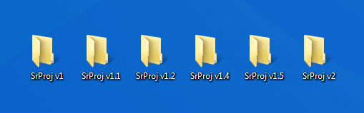

The “Save As…” Method
This is a problem!
Notes:
Who, by a show of hands, has folders like this on their computer?
Who is using dropbox and thinks they are versioned and backed up?
What happens when two people edit the same file?
Who has made a change to their code or design and wished they had a backup?

Slide 3
What does a git do?
Time Travels
Droboxes
Forking and Un-forking
Oops. Ctrl-Z
Track Changes & lay blame
Backup and Restore
Synchronization & Collaboration
Branching and merging
Undo
Track Changes & Ownership
Notes:
Well It turns out we have a tool called git that is really good at saving us from those pitfalls.
Git has awesome powers, it knows how to time travel, dropbox, undo…..
Git is very good at tracking text files, and just okay at tracking binary files. – Own Slide?

Slide 4

What is Git?
Noun
an unpleasant or contemptible person.
Proper Noun
a widely used version control system for software development. It is a distributed revision control system with an emphasis on speed, data integrity, and support for distributed, non-linear workflows. Git was initially designed and developed by …
Notes:
Can anyone complete the sentence?
Anyone read the Wikipedia page?

Slide 5
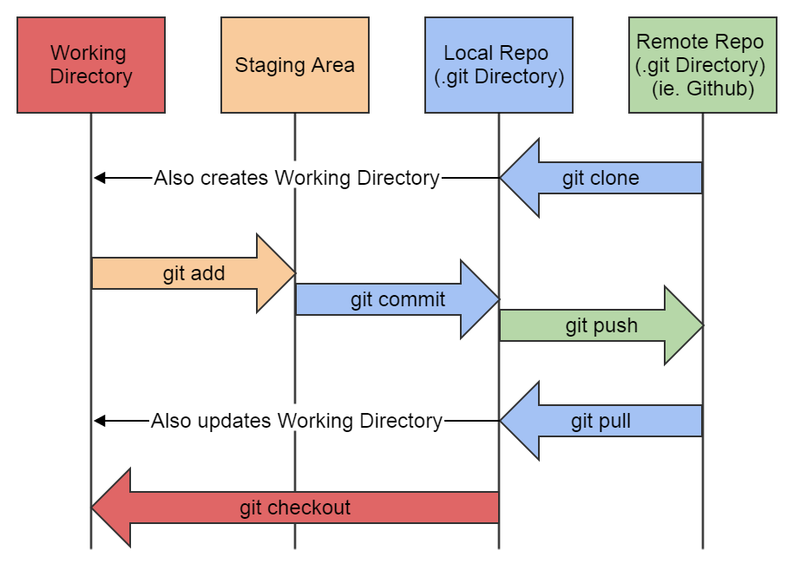
Understanding the a git flow
git clone –or- git init
<make changes>
git add
git commit
git push
git pull

Slide 6
Understanding Pushing & Pulling

Slide 7
Modules
Getting setup
Time Travel

Slide 8
Module 1: Getting Setup
software, accounts and credentials

Slide 9
Installing git
1
Who does not have git installed? Raise your hand in shame!
Linux
# apt-get install git -y
# yum install git
Mac OSX (use homebrew)
# brew install git
Windows (use Cygwin)

Slide 10
Installing gcc how else would you compile your code
1
Who does not have git installed? Raise your hand in shame!
Linux
# apt-get install gcc -y
# yum install gcc
Mac OSX (use homebrew)
# brew install gcc ???
Windows (use Cygwin)

Slide 11
Tell git who you are treat it better than your companion cube
1
git config --global user.name "Your Name"
git config --global user.email "your_email@whatever.com"

Slide 12
Line Ending Preferences why can’t we all just agree and be friends
1
Unix/Mac users:
git config --global core.autocrlf input
git config --global core.safecrlf true
And for Windows users:
git config --global core.autocrlf true
git config --global core.safecrlf true

Slide 13
Forge your new identity ssh key identity that is
1
https://help.github.com/articles/generating-ssh-keys/
Understanding public key cryptography

Slide 14
Integrate a host github, bitbucket, gitlab
1
Create an account
Add your ssh PUBLIC Key
Create Repo
PUSH!

Slide 15
Module 2: Time Travel
backup, restore and view code versions

Slide 16
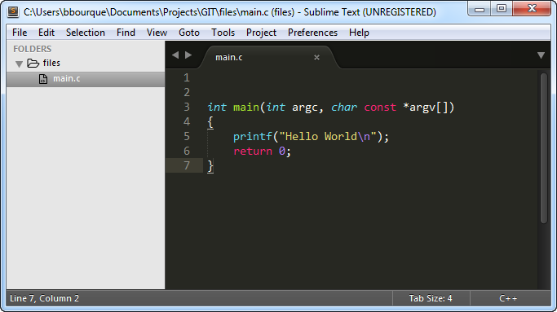
Create your program
2
Create a main file
Notes:
Before we time travel we’ll need to build our history
Lets write a C program to print a message.

Slide 17
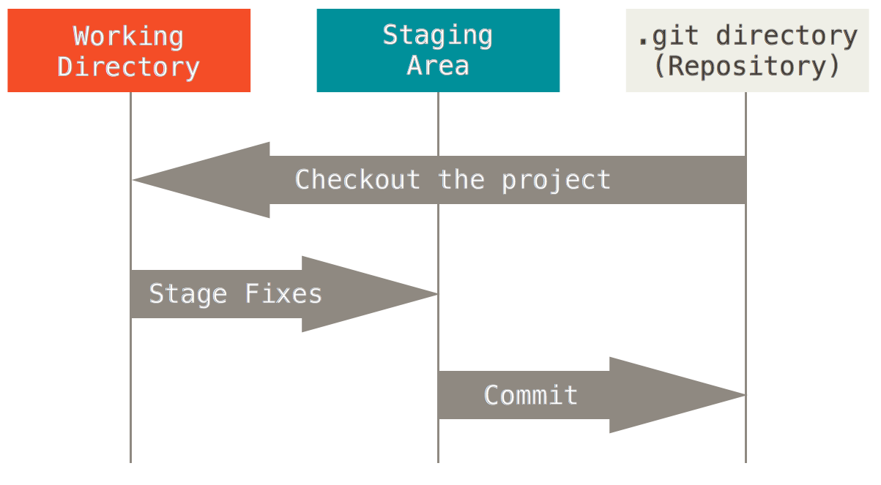
Creating History Creating a repository…
2
Creating a repository
Adding to the staging area
Ignoring files
Committing staged changes
Making more changes
Stage & Commit
Partial stage add –p & globbing
check the status!

Slide 18
Viewing History
2
Avoid committing compiled files

Slide 19
Reverting History
2
Don’t forget about undoing local changes

Slide 20
Best Practices
2
Avoid committing compiled files

Slide 21
Type Less. Do More. The magic of git-number
https://github.com/holygeek/git-number

Slide 22
Module x: Tricks & Treats

Slide 23
Submitting Logs for Senior Project
x
Use tags each time you output your logs
Here is the command:
Use enscript here is how to set header

Slide 24
Resources
http://gitimmersion.com/

